Slide 1
Detecting Early Signs of Cyberbullying in Social Media
Under the Guidance of Dr. Rishabh Kaushal
Department of Information Technology
Presented By : Neha Dubey(01602192021)
M.Tech in Cyber Security

Slide 2

Introduction
The Term CyberBullying is used to describe bullying taking place on the internet(through mobile phones, laptop etc.)
Bullying is generally used as an aggressive or intentional act or behaviour carried out by group or an individual repeatedly and over time against a victim who can not easly defend him or herself..

Slide 3


Bullying Vs Cyber-Bullying

Slide 4
Why it is important?
⅓ has been victim and nearly half of suicide case amoung 10-14 year olds are due to bullying
The American Academy of Pediatrics reports that children in third through fifth grades that own cell phones are more likely to be victims of cyberbullying. “Parents often cite the benefits of giving their child a cell phone, but our research suggests that giving young children these devices may have unforeseen risks as well,” said Elizabeth K. Englander, Ph.D., a professor of psychology at Bridgewater State University.

Slide 5
Why Children Do CyberBully?
Revenge
Frustration
Entertainment
Anger
Others

Slide 6
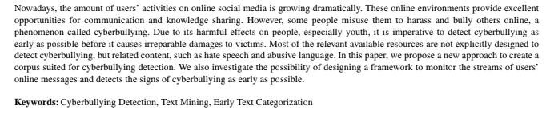
Research Paper -

Slide 7
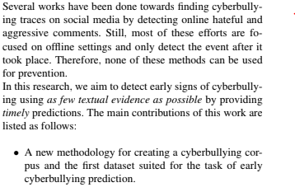
Preparation of Datasets

Slide 8
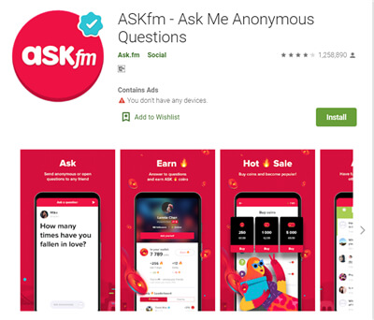
Data Collection
Abusive language detection can be considered as the initial step towards finding cyberbullying incidents. Cyberbullying happens when the victim receives several offensive messages repeatedly. Therefore, at least parts of the users’ conversations should be monitored to detect such episodes.
Author collect data from ask.fm.4

Slide 9
Users can ask questions anonymously or with their identity attached. The platform also allows paid members and top users to start private conversations. Others can converse in public with or without their identity revealed.
Ask.fm allows users to post answers on their profile. These can be in text, video, or picture format. The answers you post can be liked by others or reacted to with a fire emoji. Currently, the mobile app is more interactive than the browser version.

Slide 10
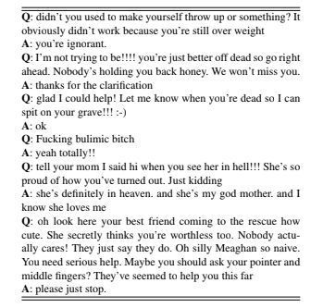
We collect a large amount of ask.fm data, including the full history of question-answer pairs for 3K users. The question field includes a question/comment posted by the other users, and the answer field consists of the reply to that question/comment provided by the owner of the account.

Slide 11
We utilize the ask.fm corpus proposed in the same work for training the model and label each row of our data automatically. To make the cyberbullying instances, we create a fixed-length sliding window and move it through the whole history of question-answer pairs per user. For each window sample, we calculate the ratio of offensive questions/comments that the user received inside the window. If it is greater than a pre-defined threshold, we consider the window as a potential cyberbullying event.
We divide all training and test examples to 10 different chunks to make the corpus suitable for early text classification. For every instance, each chunk contains 10% of all thequestion-answer pairs for that user.

Slide 12
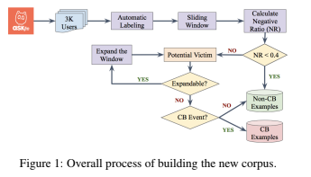
Corpus creation:

